Slide 1
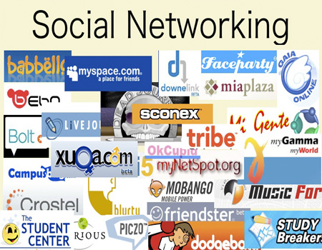
April 18, 2008
CSCI 110
Bowring
Tisha King
Nicole McCollin
E.J. Merlin

Slide 2
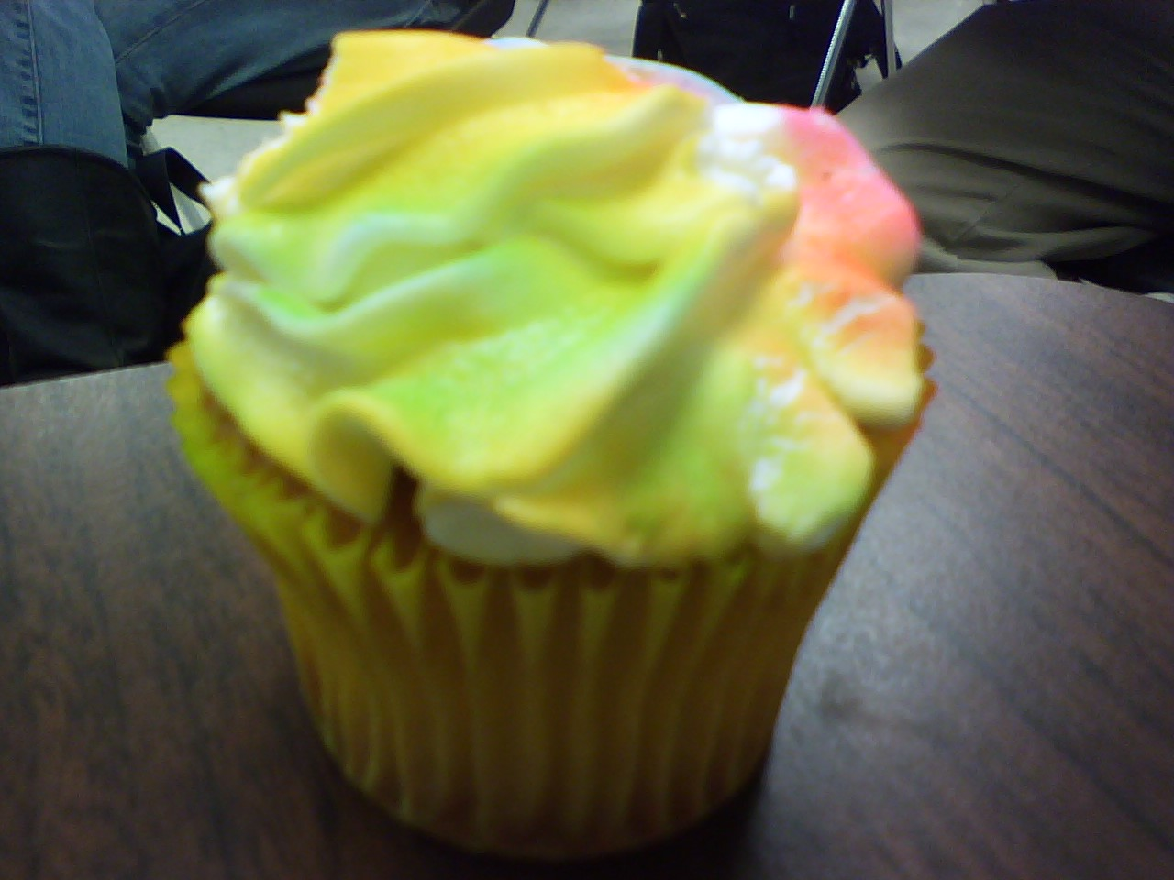
What is social-networking?
Websites providing a way for friends and family to stay in touch
A way to meet new friends
A method for promoting business such as artists, bands, etc…

Slide 3
Was created by Jonathan Abrams in 2002
Popular site until in 2004 when Myspace began increasing in popularity
Has over fifty million users
Completely free to use

Slide 4
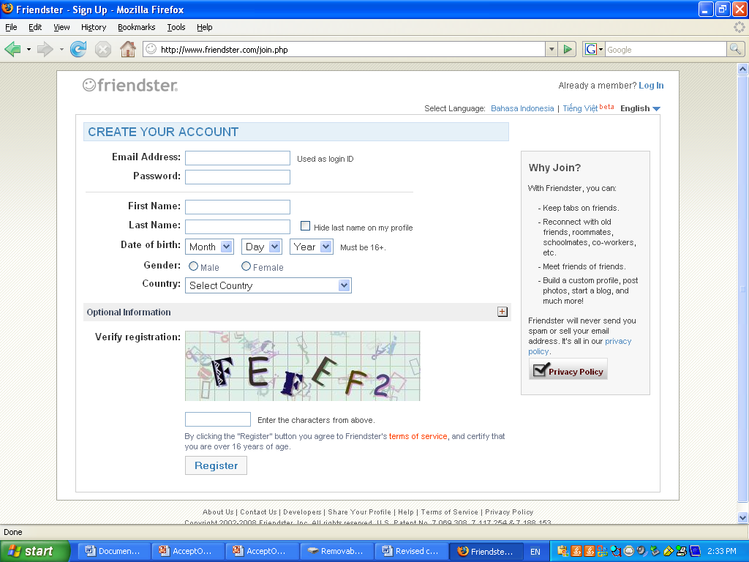
Initializing an account
Set up was simple
All you need is a valid e-mail address

Slide 5
Features
Customization
  Site provides backgrounds for the users
Applications
  264 different applications available that you can add to your page (includes things like games and blogs)
Finding friends
  Can browse people by photos, video, school, e-mail address
Photos
  Add unlimited amount of photos and categorize them into albums

Slide 6

Privacy
Ability to block content from specific users
Can decide who can leave comments, how a friend is accepted, and what information is displayed on your page such as:
  birthday
  last name
Can also decide if another person can use your photos

Slide 7
Ease Of Use
User friendly
  customization is easy as no knowledge of html is needed
Takes a while to become comfortable navigating the website because content is overwhelming
http://profiles.friendster.com/user.php

Slide 8

Social-networking website used by over 100 million people worldwide
Launched in August of 2003
Completely free to use

Slide 9
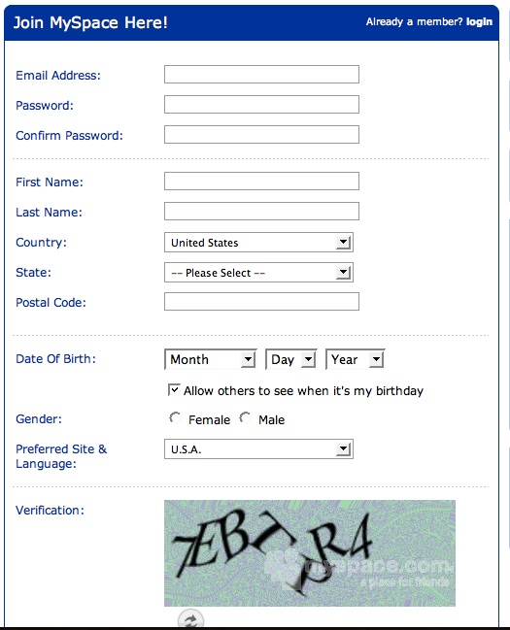
Initializing an account
All you need is a valid e-mail address

Slide 10
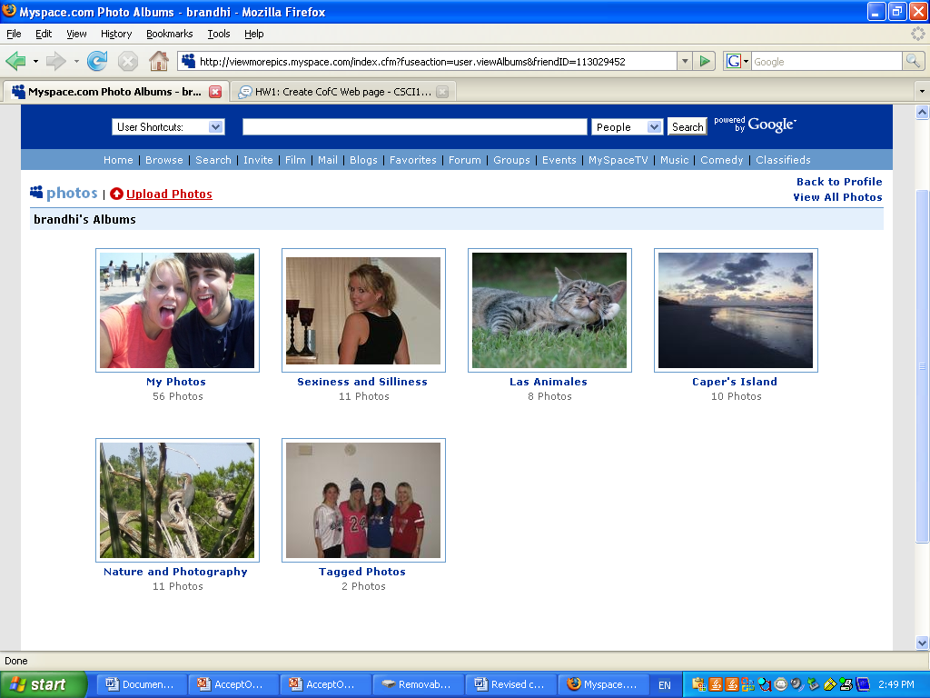
Features
Photos
  an unlimited amount
  can create photo albums
  can tag friends who have accounts in photos

Slide 11
Features
Customization
  is possibly endless and dependent on users knowledge of HTML
Blogs
  ability to screen who views them
  ability to control who can comment on them

Slide 12
Features Continued
Ability to add events with links to other myspace pages (for example music shows)
Add videos and music
Create events
Post bulletins, comment on other blogs, pages, and pictures
One can track changes their friends made to their pages
Have top friends
See if you and another user have mutual friends

Slide 13
Privacy
You can make your profile private
You must be at least 14 to sign up
If you are 16 and under your profile will automatically be private
If you click on a link which is not a part of the myspace webpage you will be asked if you are sure you want to go to this page
  this precaution is a new protection as to prevent third party web pages from stealing your password
Constant re-working as to prevent exposing users to viruses

Slide 14
Ease Of Use
Myspace is fairly user friendly
  it’s initial appeal was that it was easier to use then friendster
The help myspace offers to its users is sub-par as compared to other social networking websites
http://www.myspace.com

Slide 15

Created by Mark Zuckerberg
64 million active users world wide (Krivak, 2008)
Anyone over the age of 13 can have an account
Completely free to use

Slide 16

Mark Zuckerberg

Slide 17
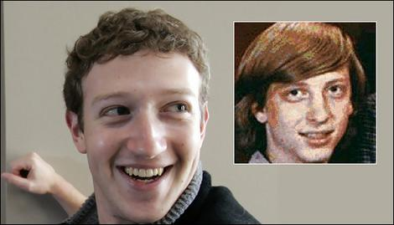
Zuckerberg Before and After the Fame

Slide 18
Little Known Facts
Created in 2002
Originally called “The Facebook”
Expanded to the U.S. and 7 other English speaking countries
250,000 new members each year
CEO is actually a Harvard dropout
Microsoft valued it at $15 billion dollars in 2007
Has become the 2nd largest social networking site (MySpace)
CEO announced the launch of a French version at the South by Southwest Interactive Festival in Austin, Texas
In 2007, hired both Sheryl Sandberg and former YouTube chief financial officer Gideon Yu from Google as Chief operating officers

Slide 19
Jessica Bennett of Newsweek describes Facebook as a “revolutionary way to stay in touch, network, build shrines of yourself, and procrastinate on the job.” “It is, without a doubt, a social phenomenon.”

Slide 20
Initializing an account
You have to have a valid e-mail address
Must include name and birthdate
Very easy to create

Slide 21
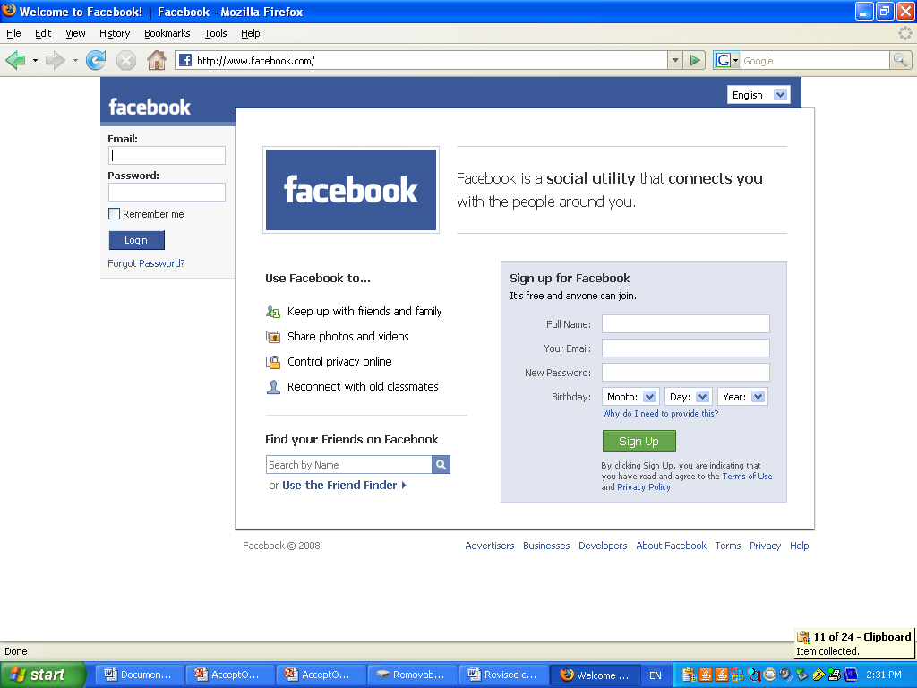

Slide 22
Networks
Over 30,000 including
  High School/College
  Community
  Work place

Slide 23
Profiles
More fields have been added and users can share more information than ever before
A typical Facebook profile consists of different sections including information, status, friends, friends in other networks, photos, notes, groups, and the wall

Slide 24
Facebook Photos
Most popular feature- over 1.5 million photos uploaded daily!
Unlimited number of photos can be uploaded, HOWEVER only 60 are allowed per album

Slide 25
Groups
Users can create new ones or join existing ones
Great indication of hobbies and interests one might have

Slide 26
Events
Provides ability to organize, be apart of, and plan for events
Extremely successful with the organization and planning of parties
Can invite others to events BUT! Often contributes to the outbreak of underage drinking and campus violations

Slide 27
Notes
Newest addition.. Allows users to write and create BLOGS (online journals)

Slide 28
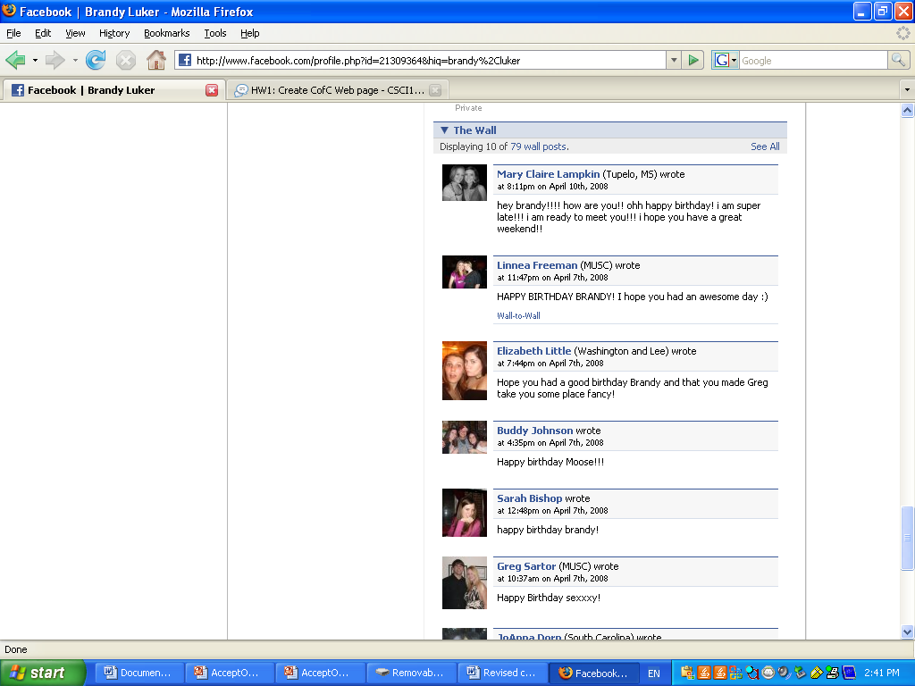
Features
Wall
  Leave comments, pictures, graphics

Slide 29
Privacy
You must agree to the terms of use, privacy policy, and code of conduct
You have to be at least 13 to have an account but if you are under 18 you have to be in high school or college
  when you agree to the terms of use, you are agreeing to this
Facebook advices you NOT to provide personal information such as address and phone numbers on profiles
Limited Profiles
  choose who can view your profile and certain aspects of it as well

Slide 30
Ease of use
Very easy to use
There are how to websites that provide step-by-step instructions

Slide 31
Problems Encountered
There is a pending lawsuit against Zuckerberg by two of his former classmates from Harvard claiming he stole the idea to create Facebook from them
CEO launched an advertising program called Beacon which broadcasts news of users’ online purchases to their friends- invasion of privacy

Slide 32
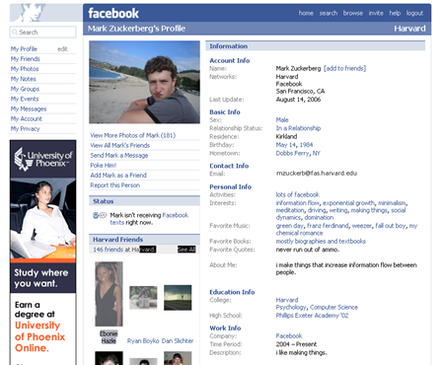
Mark Z’s profile- He only has 146 friends!

Slide 33
Facebook on 60 Minutes
www.youtube.com

Slide 34


Facebook is the winner!!!
All of the networking sites have pros and cons
Facebook seems to appeal most when it comes to overall quality because it offers such a vast array of resources and uses.
It’s not just for social purposes: users also network as well as plan, organize,
and broadcast local and campus wide
events and activities

Slide 35
Works Cited
Krivak, Thomas. “Facebook 101: Ten Things You Need To Know About Facebook.” Information Technology 25.3(2008): 1-44, 3p, 1c.
Bennett, Jessica. “Your Profile is Not Cool.” Newsweek 151.10(2008): 12-13.
Ante, Spencer, Holahan, Catherine. “Facebook CEO Admits Missteps.” Business Week Online (2008): 1, 1p.

